Slide 1
Inte 210 presentation and color rendering
VISUAL PERCEPTION

Slide 2
Note: Under “fair use” These images are for educational purposes only. They may not be shared or reproduced.

Slide 3
TEXTURE PERSPECTIVE

Slide 4
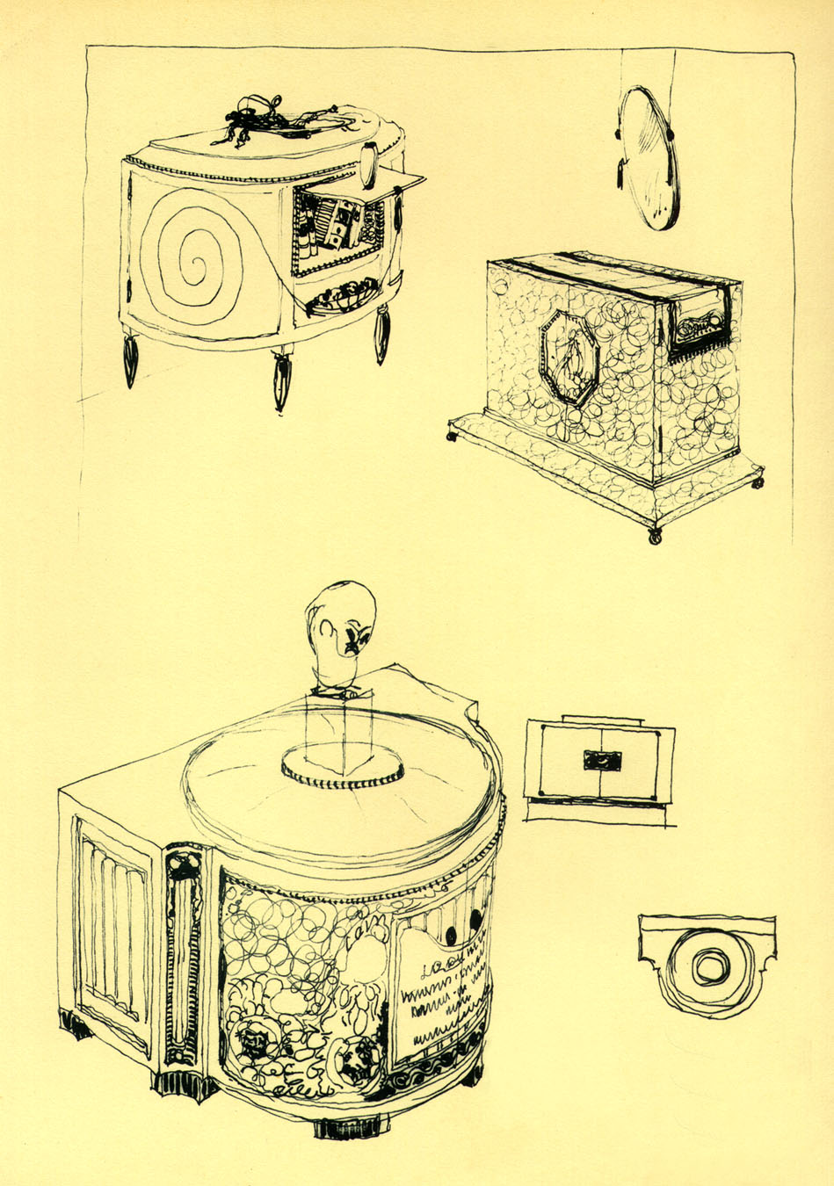
Note texture perspective in conceptual sketch from emile Jacques ruhlman
See texture get smaller and softer on far end of cabinet on right

Slide 5
Size perspective

Slide 6
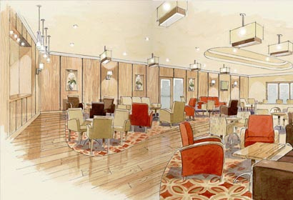
SIZE PERSPECTIVE
NOTE CHAIRS IN FOREGROUND APPEAR LARGER THAN THOSE IN THE BACKGROUND

Slide 7
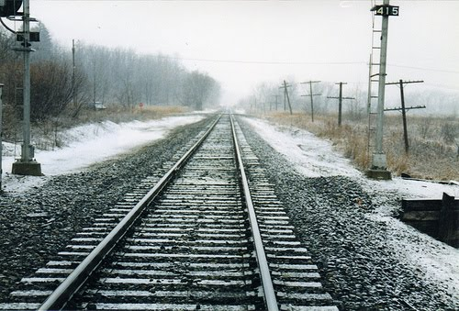
LINEAR PERSPECTIVE

Slide 8
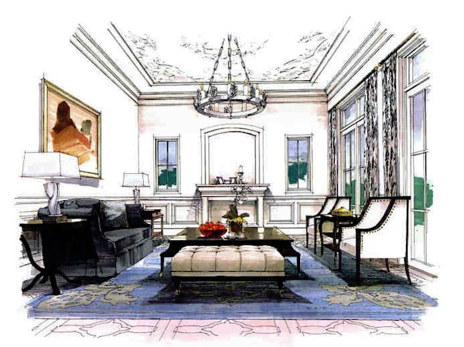
1 POINT LINEAR PERSPECTIVE OF INTERIOR. Note lines converging to a single vanishing point

Slide 9
Atmospheric perspective

Slide 11
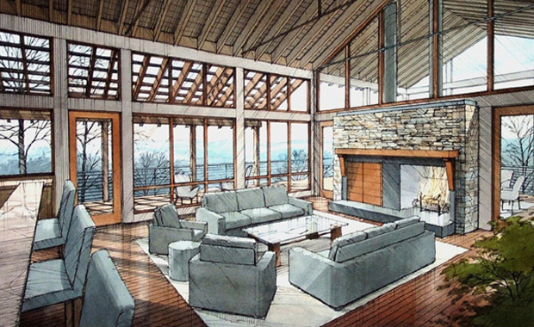
Rendering with atmospheric effects

Slide 12
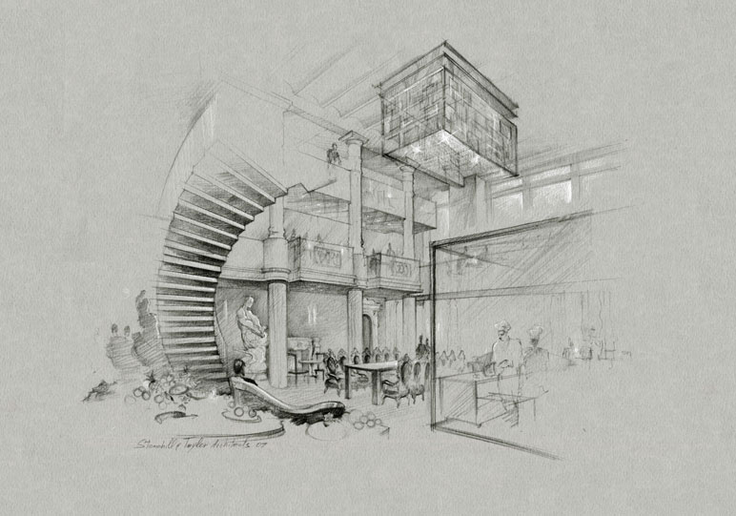
Perspective of blur

Slide 13
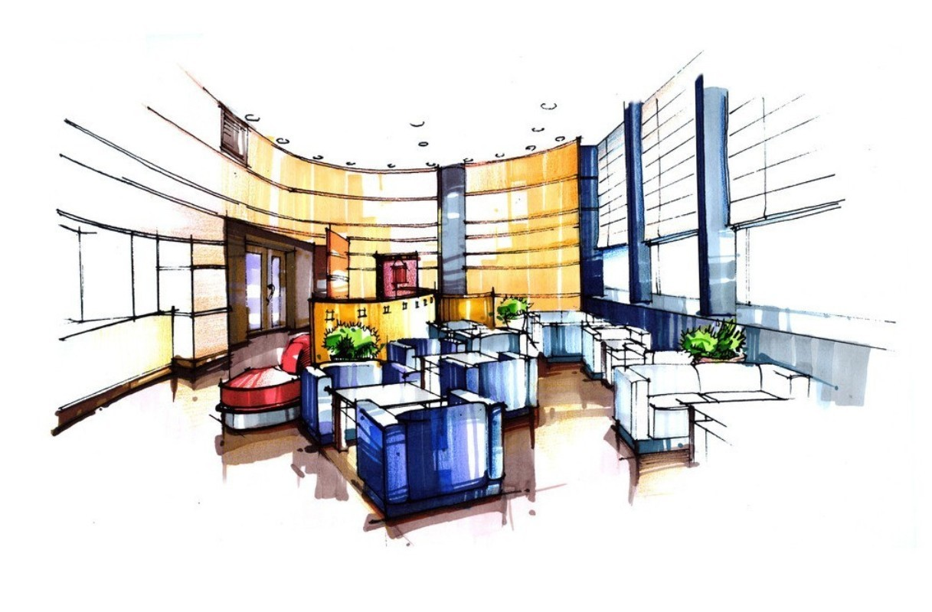
Perspective of blur is how we emphasize certain elements to become focal points and de-emphasize others.
WE WILL ALSO USE A COMPOSTIONAL FORMAT CALLED A “VIGNETTE” TO CREATE THIS EFFECT

Slide 14
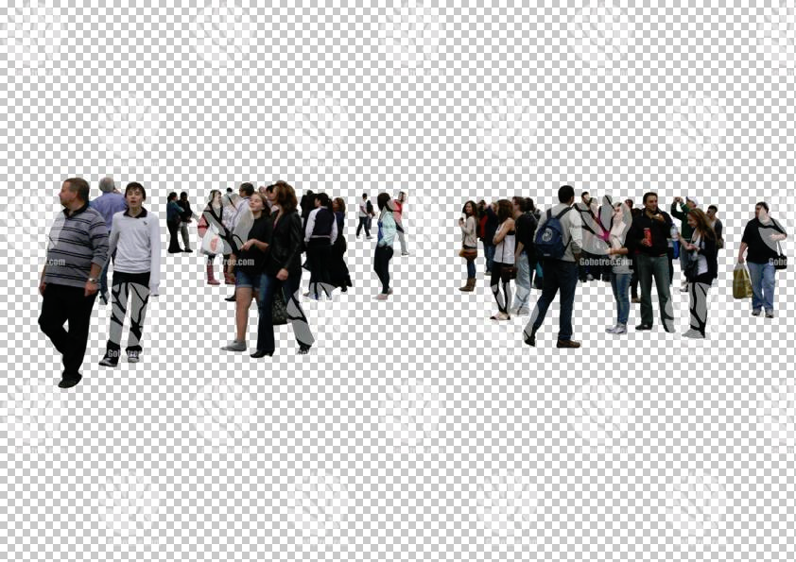
“Tiering” or the relative upward location in the visual field

Slide 15
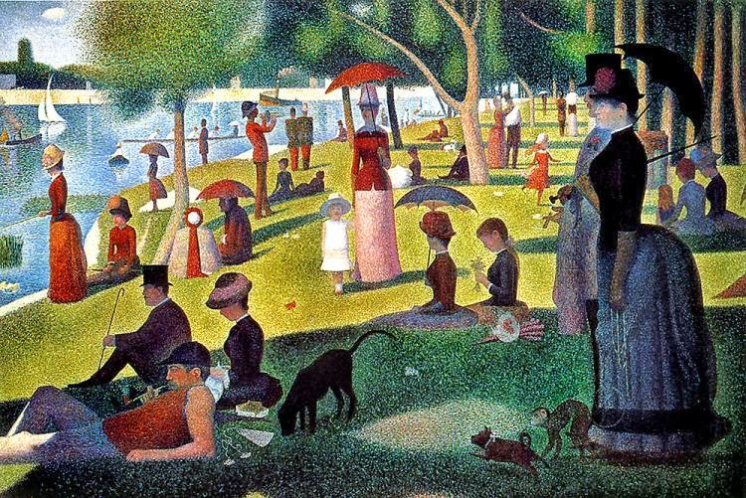

Slide 16
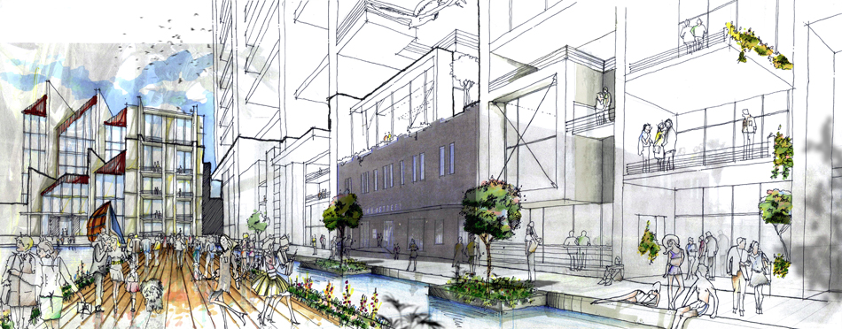
Rendering with tiering

Slide 17
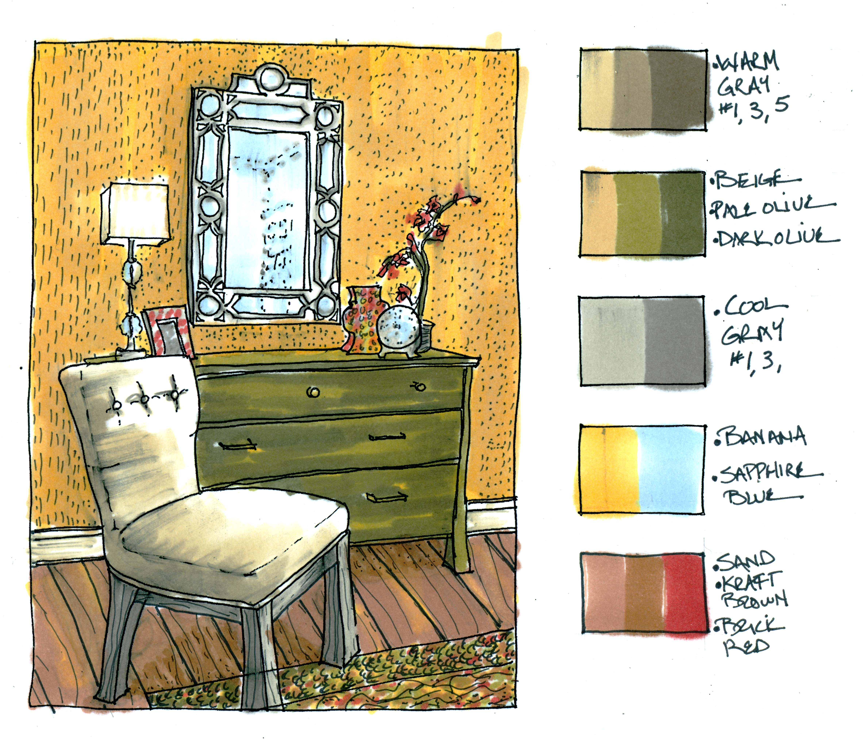
Continuity of an outline

Slide 18
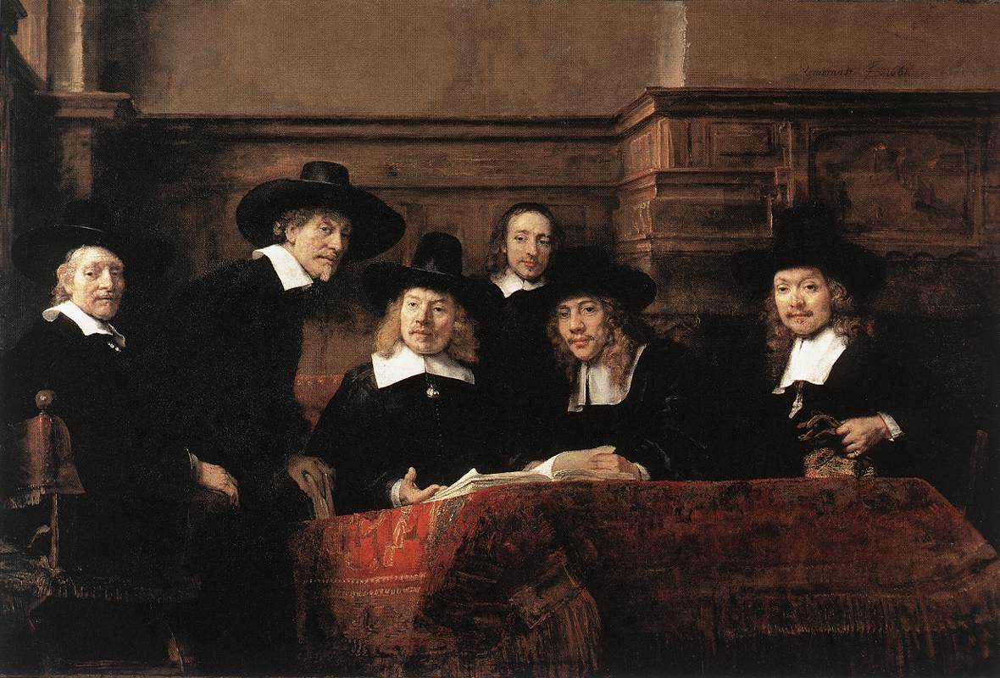
Lost and found contour

Slide 19
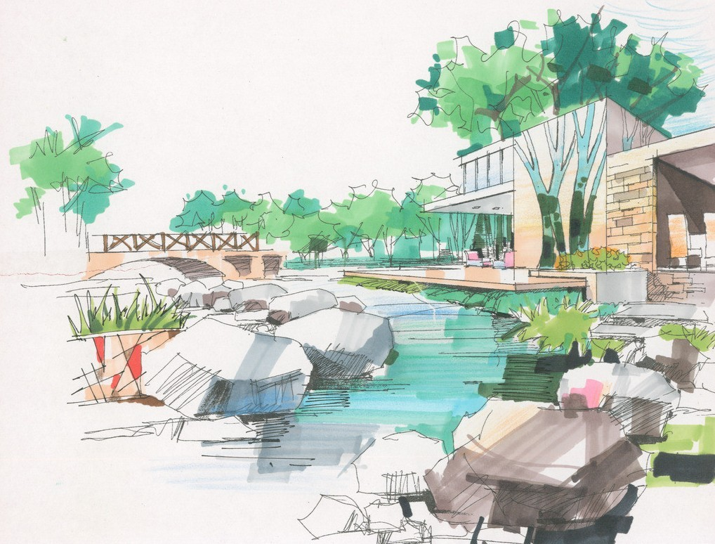
These concepts make the rendering more visually compelling as the viewer’s mind solves the puzzle

Slide 20
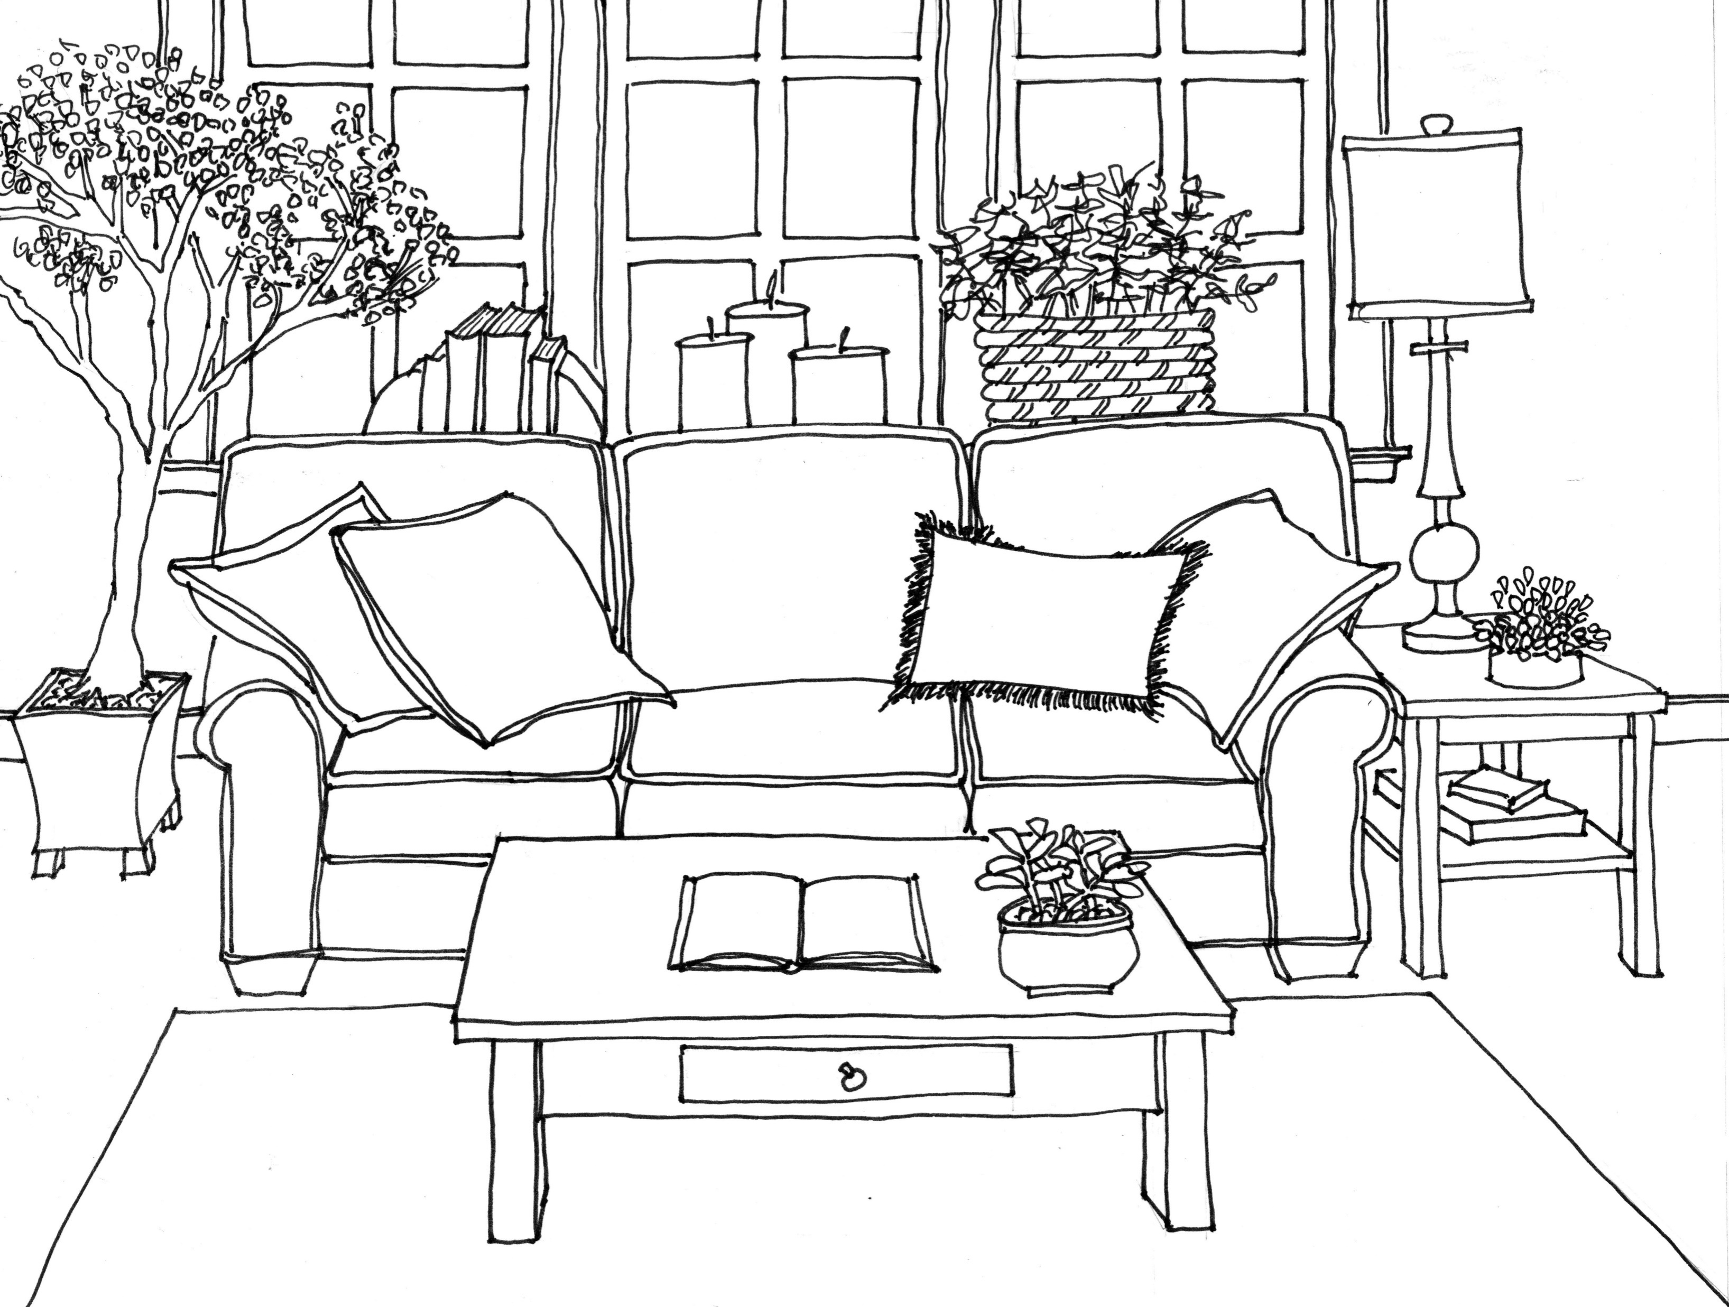
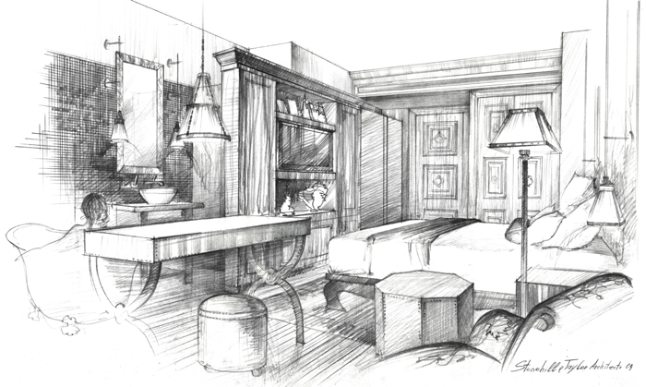
Contrast between light and dark or the use of values

Slide 21
Compare a “CAD” rendering to one that using artistry and visual perception
Hand-drawn REndering
CAD REndering

Slide 22
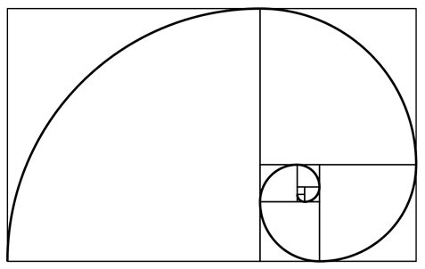
Proportion: The relative sizes of parts within a whole

Slide 23
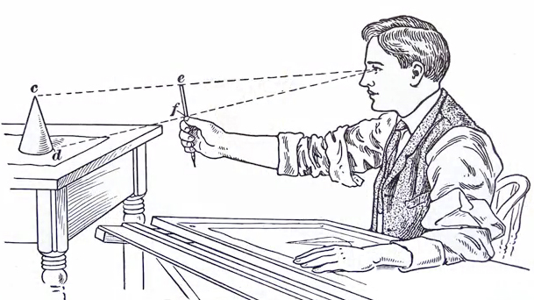
Using a tool to measure relative sizes of objects

Slide 24
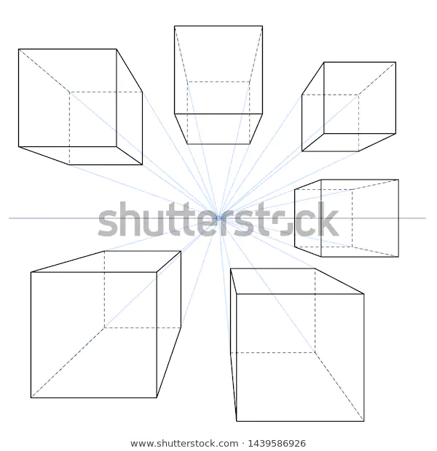
ONE POINT PERSPECTIVE
WITH 1 POINT PERSPECTIVE THE OBJECT IS PARALLEL TO OUR EYE POSITION SO FRONT AND BACK SURFACE WILL BE HORIZONTAL AT THE TOP AND THE BOTTOM WHILE THE SIDES WILL CONVERGE TO THE VANISHING POINT OR V.P.

Slide 25
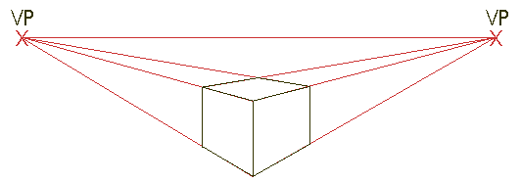
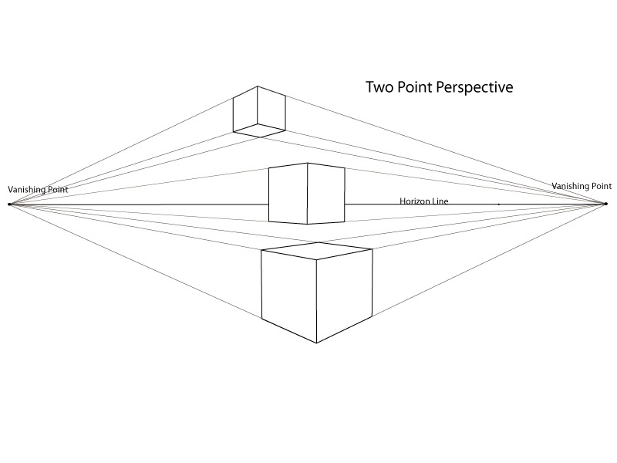
TWO POINT PERSPECTIVE
IN TWO POINT PERSPECTIVE ALL PARALLEL LINES WILL CONVERGE TO THE SAME VANISHING POINT.

Slide 26
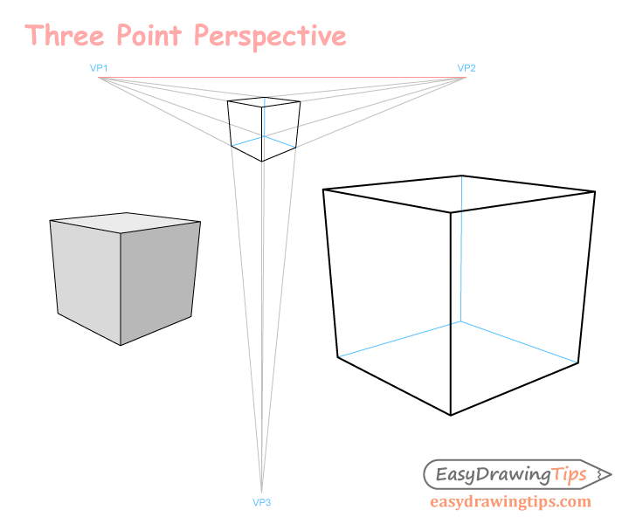
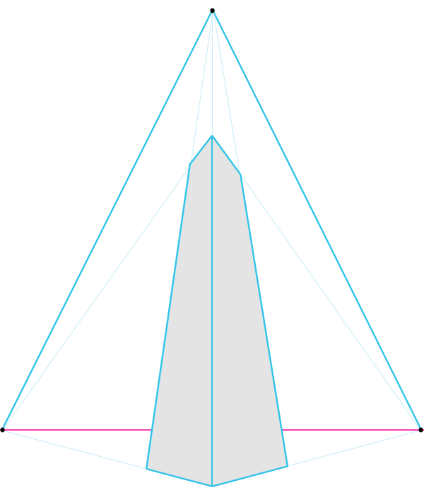
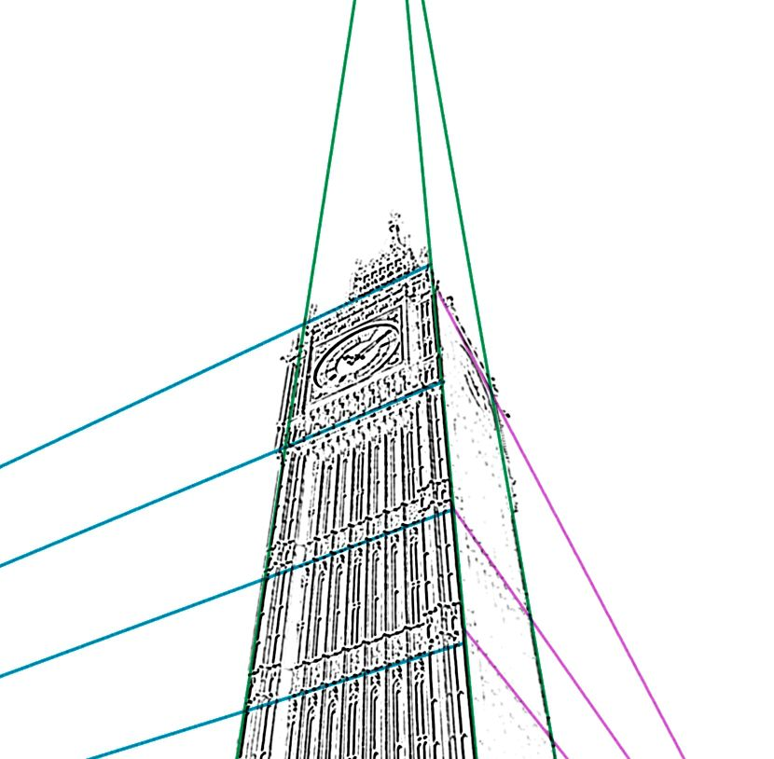
THREE POINT PERSPECTIVE

Slide 27
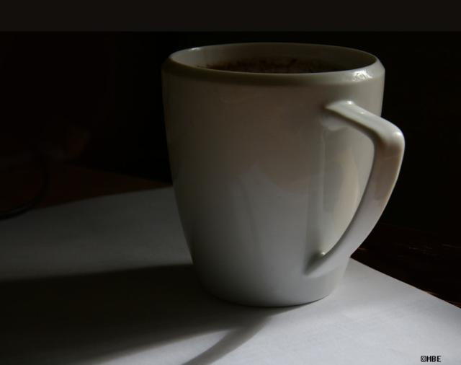

Slide 28
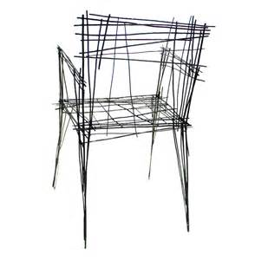

Slide 29
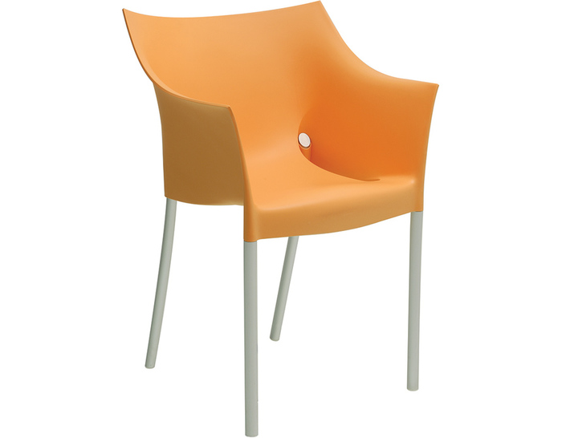

Slide 30
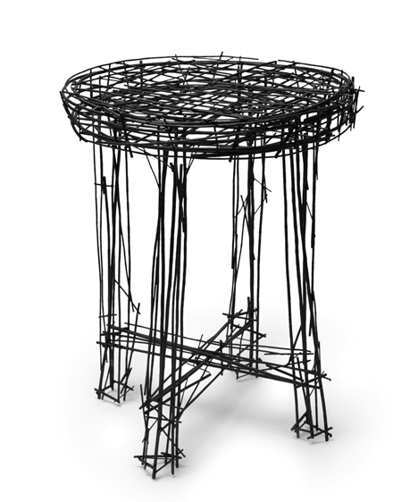

Slide 31
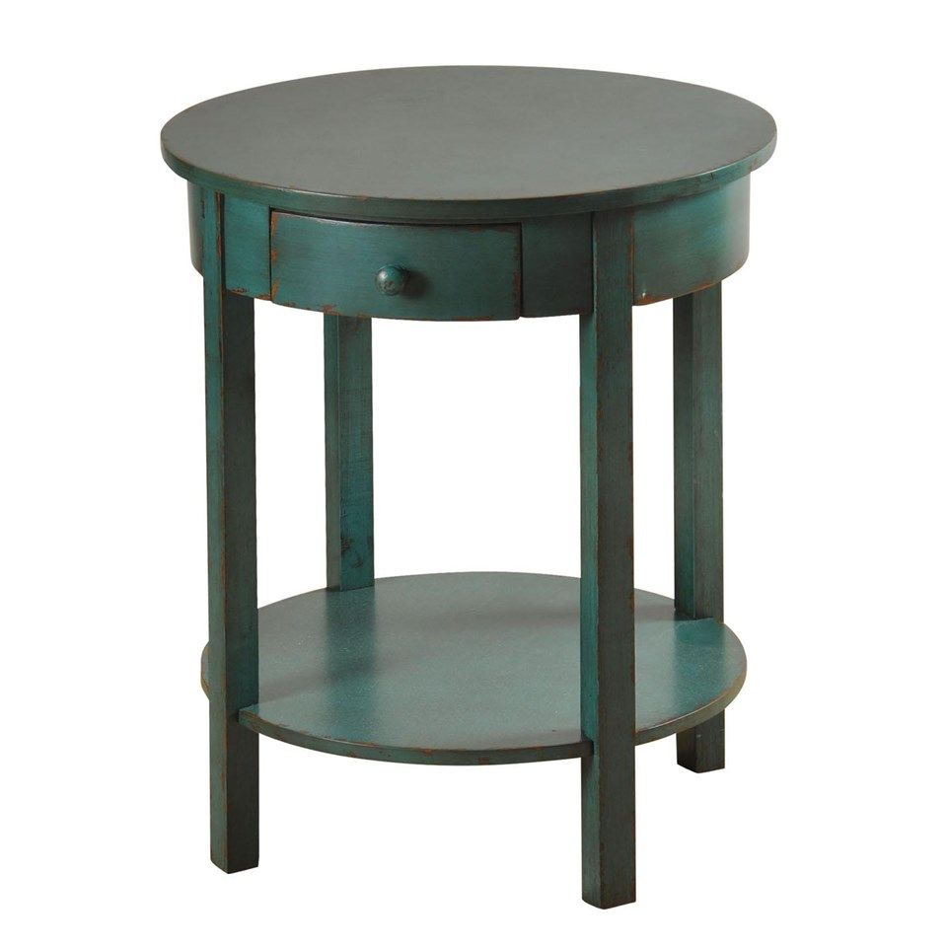

Slide 32
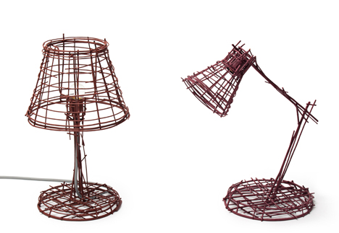

Slide 33
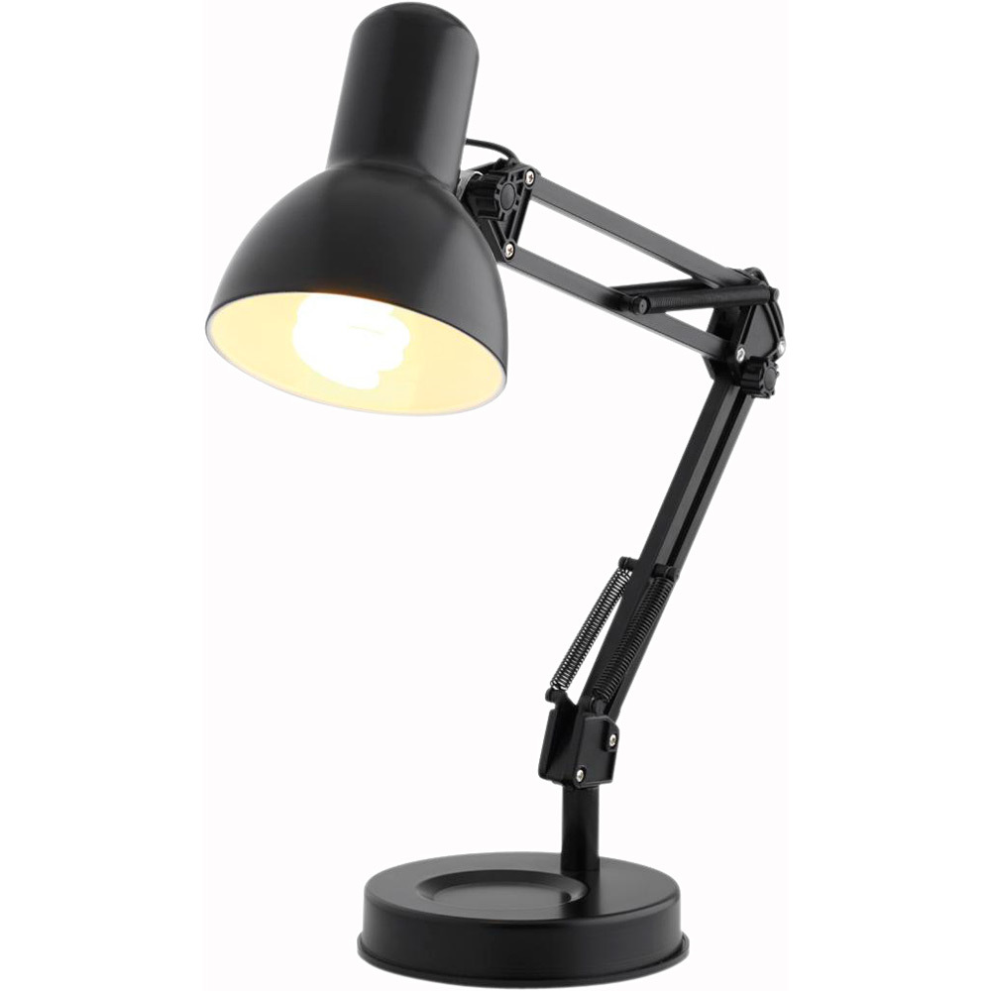

Slide 34
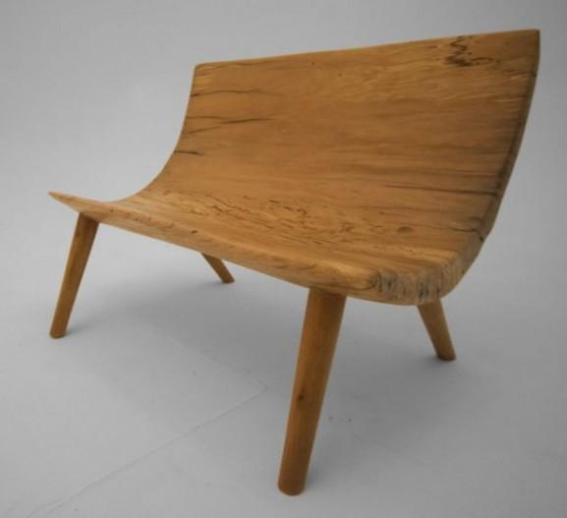

Slide 35
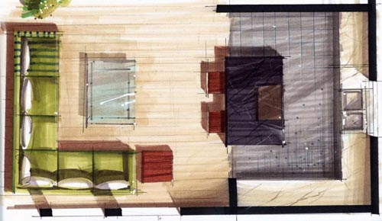
Rendered Floor plan with shadows

Slide 36
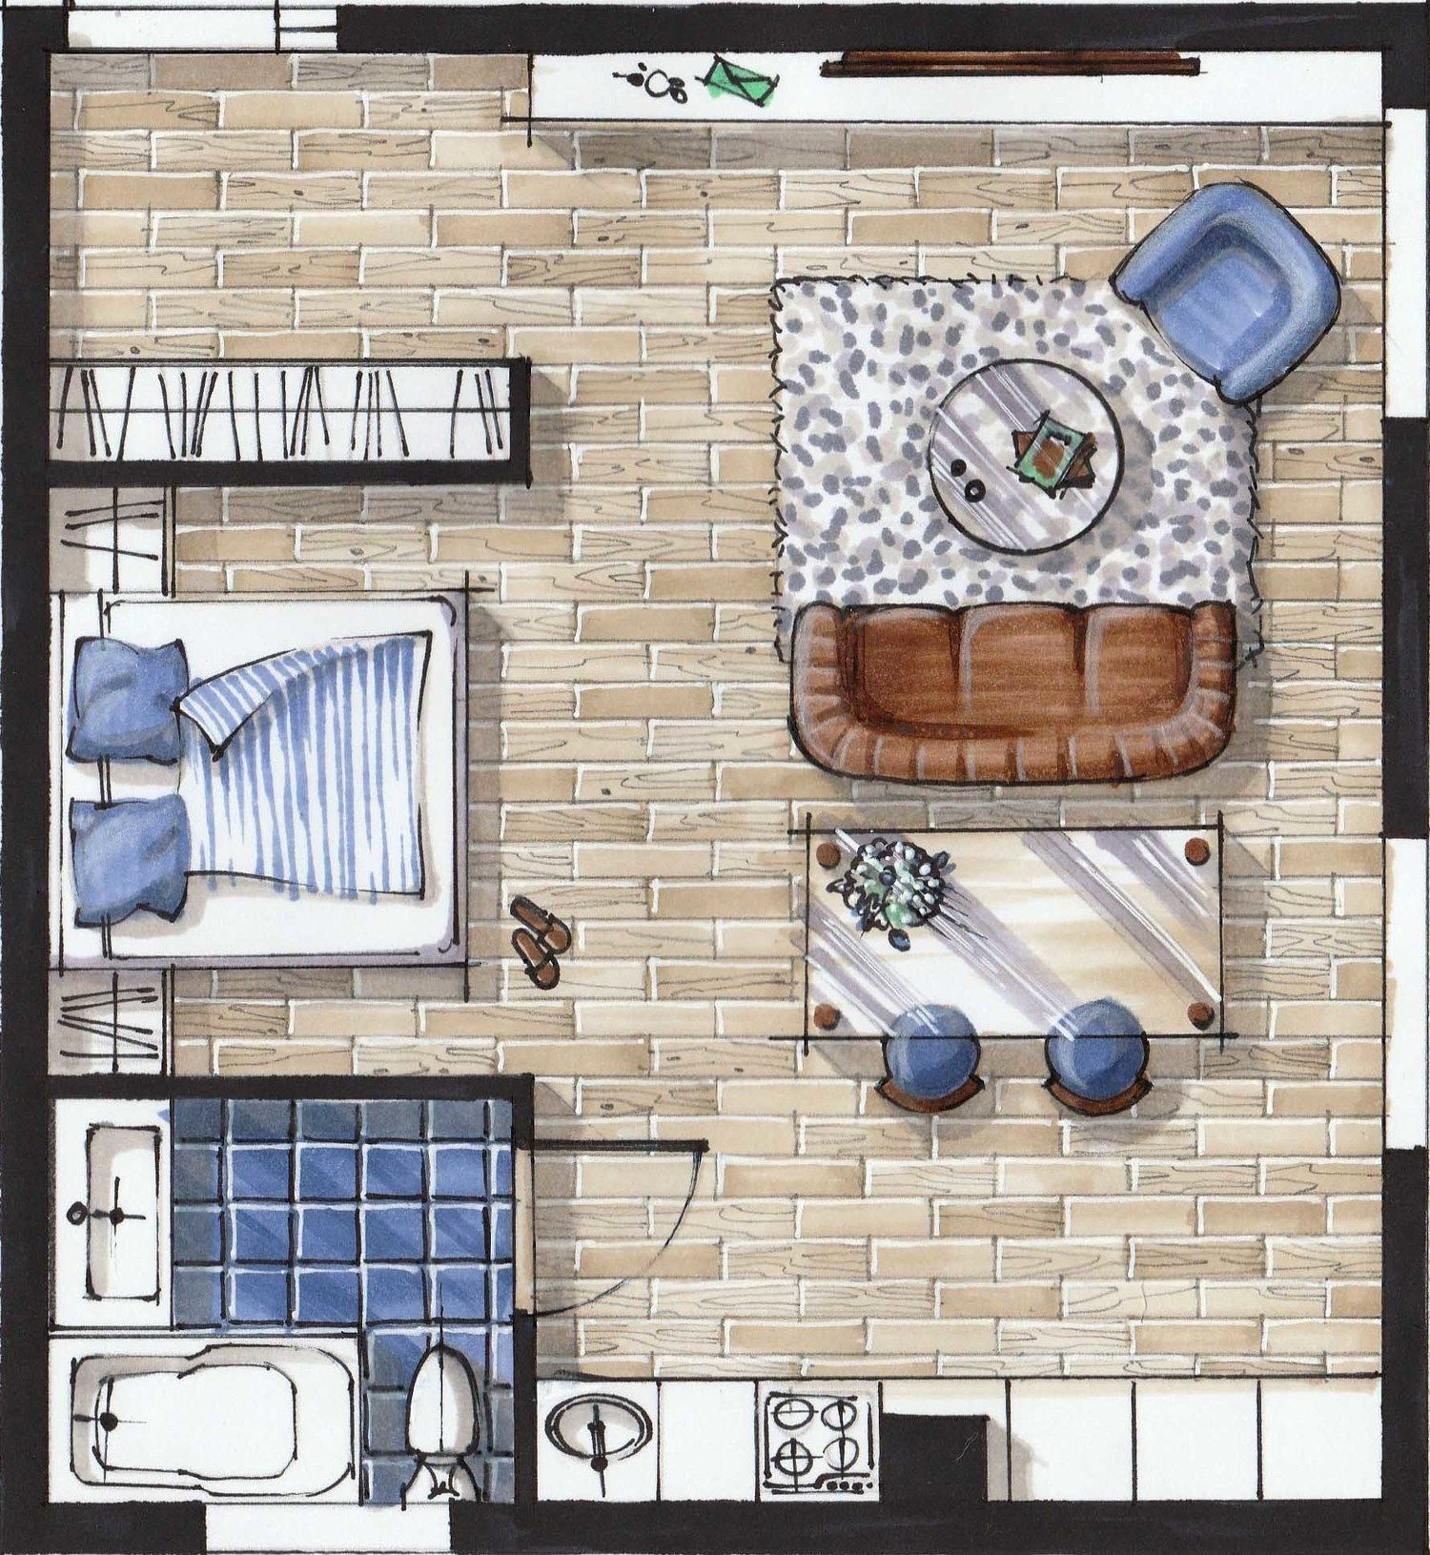
Rendered Floor Plan with Pencil textures

Slide 37
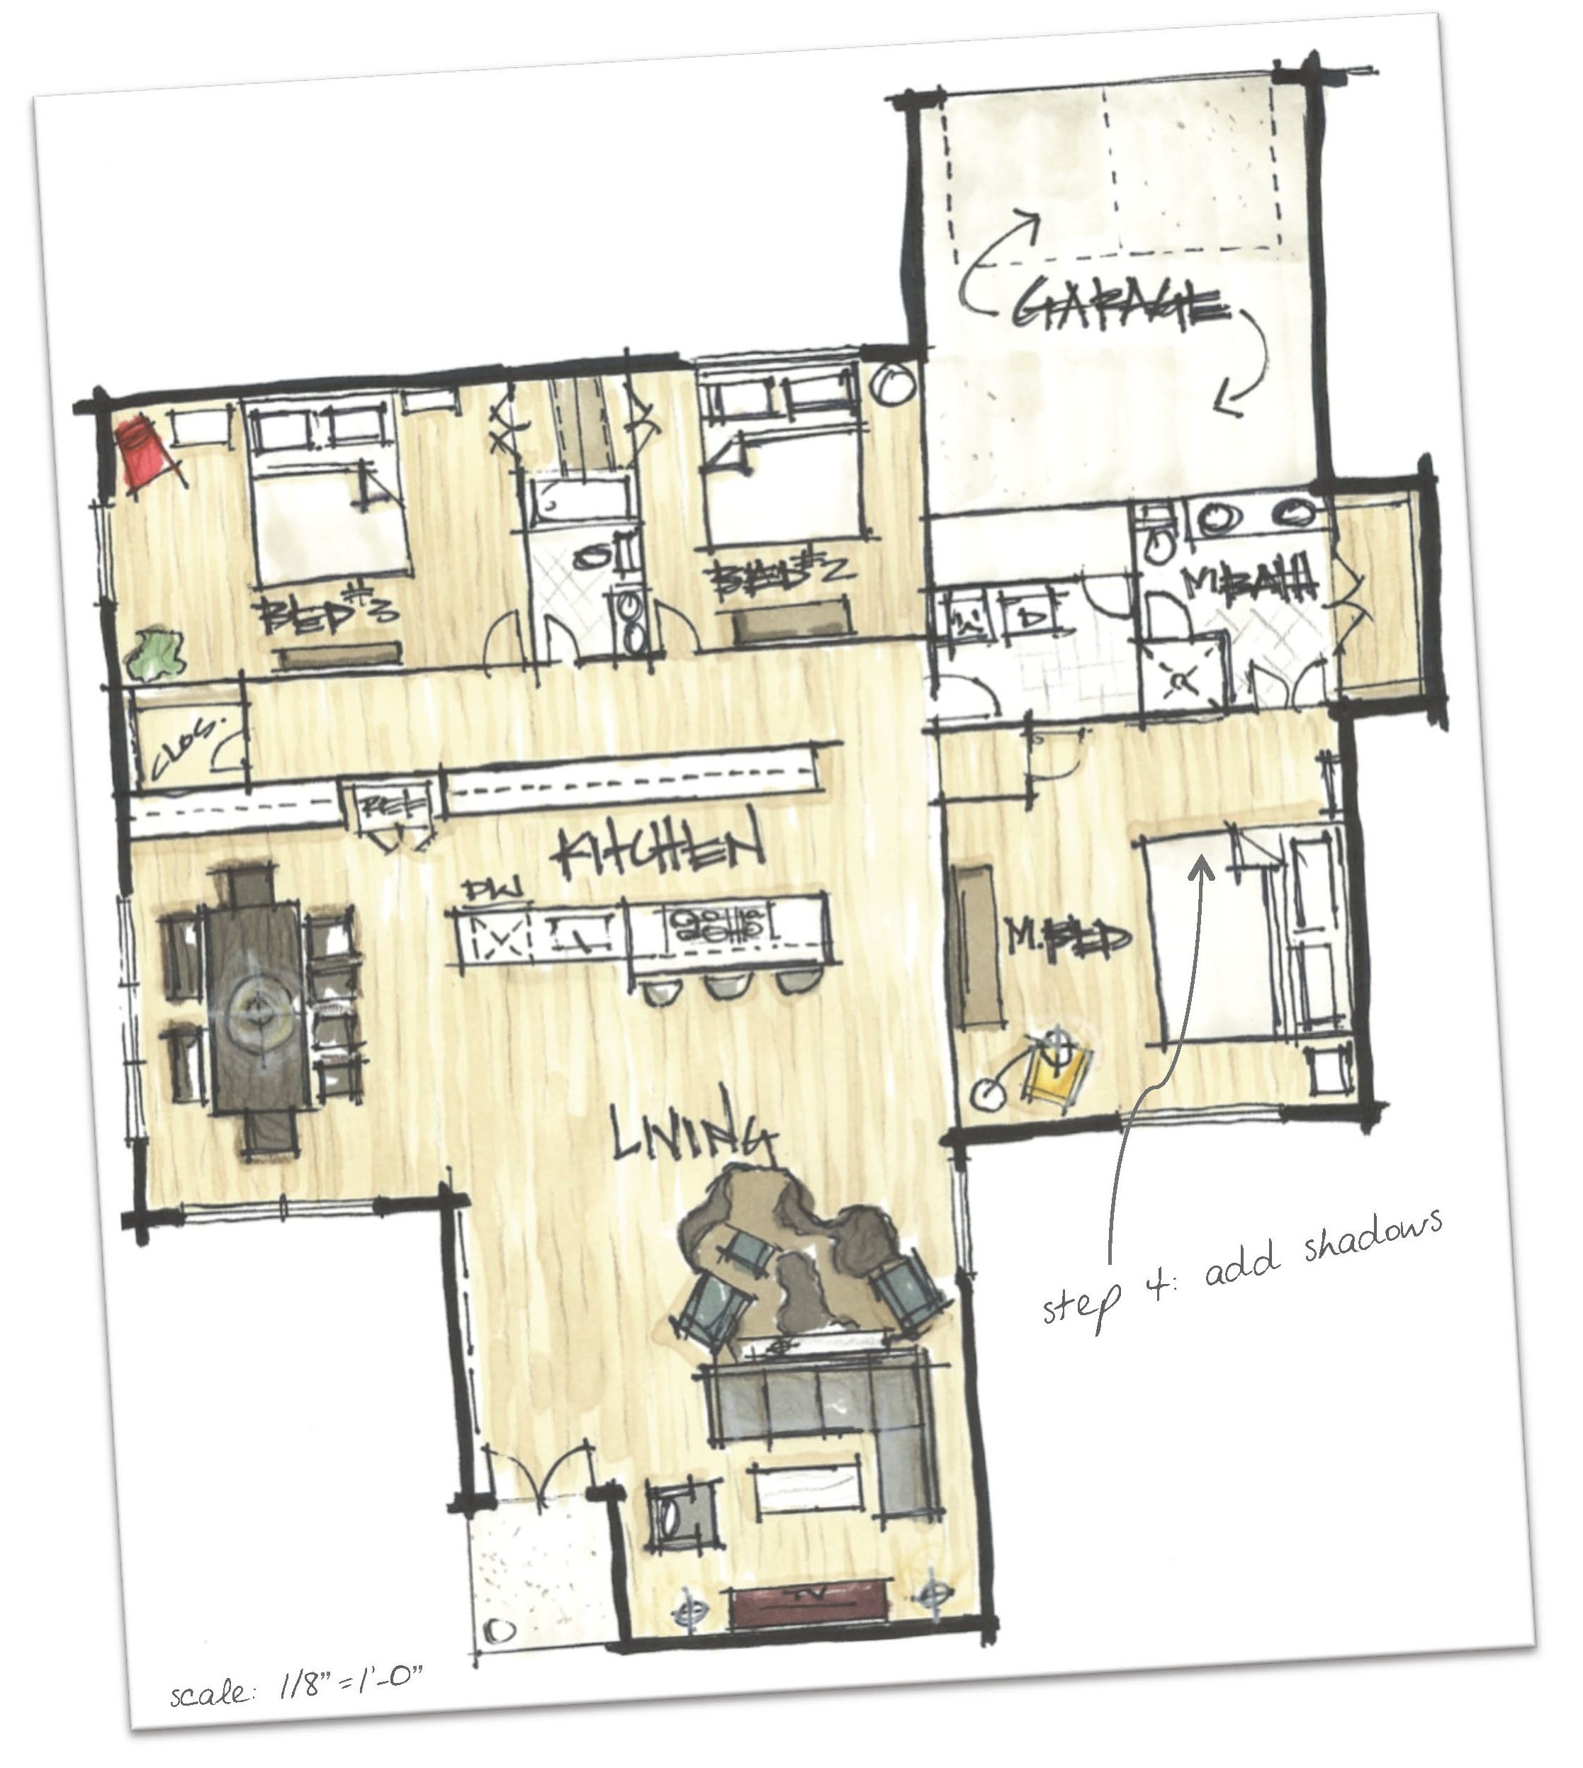
Quick sketch style rendering can be an effective way to visualize a space for yourself and others.

Slide 39
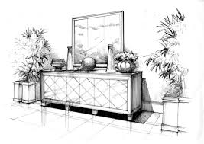
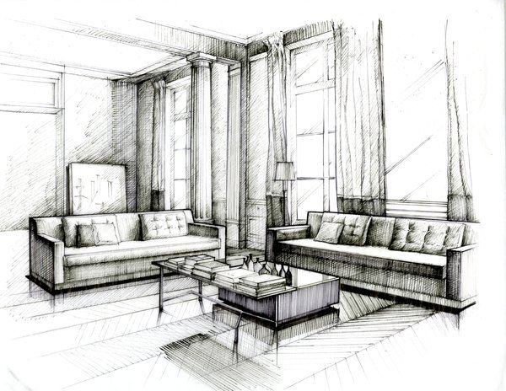
Black and White images can be a dynamic way to present a concept

Slide 40
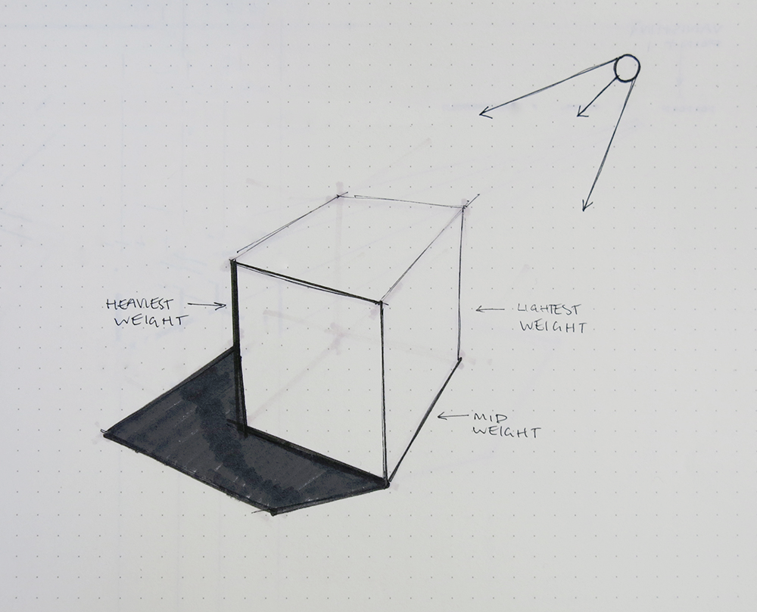
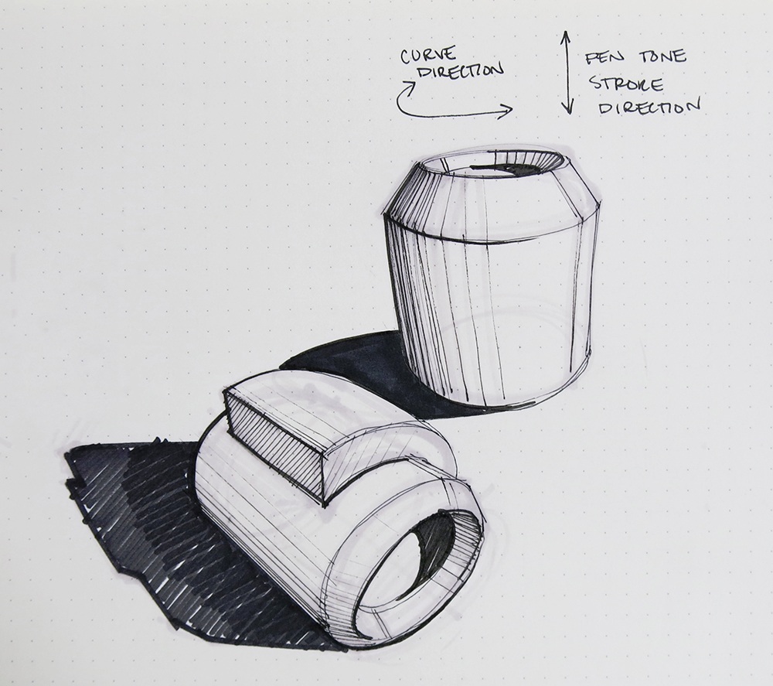
Line weight variations also help convey light source

Slide 41
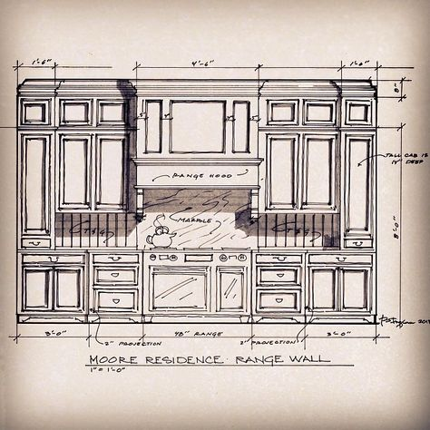
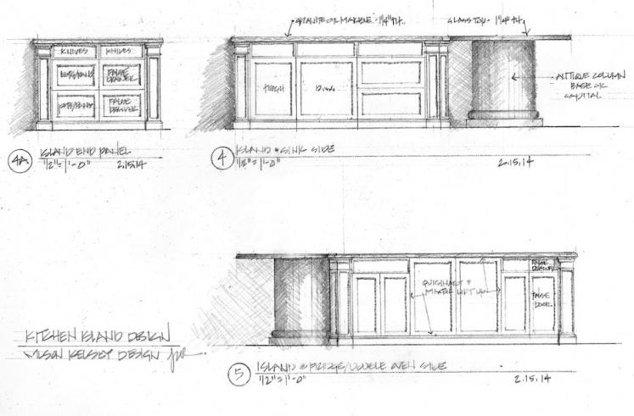
Adding shadows and line weights gives depth to elevations

Slide 42
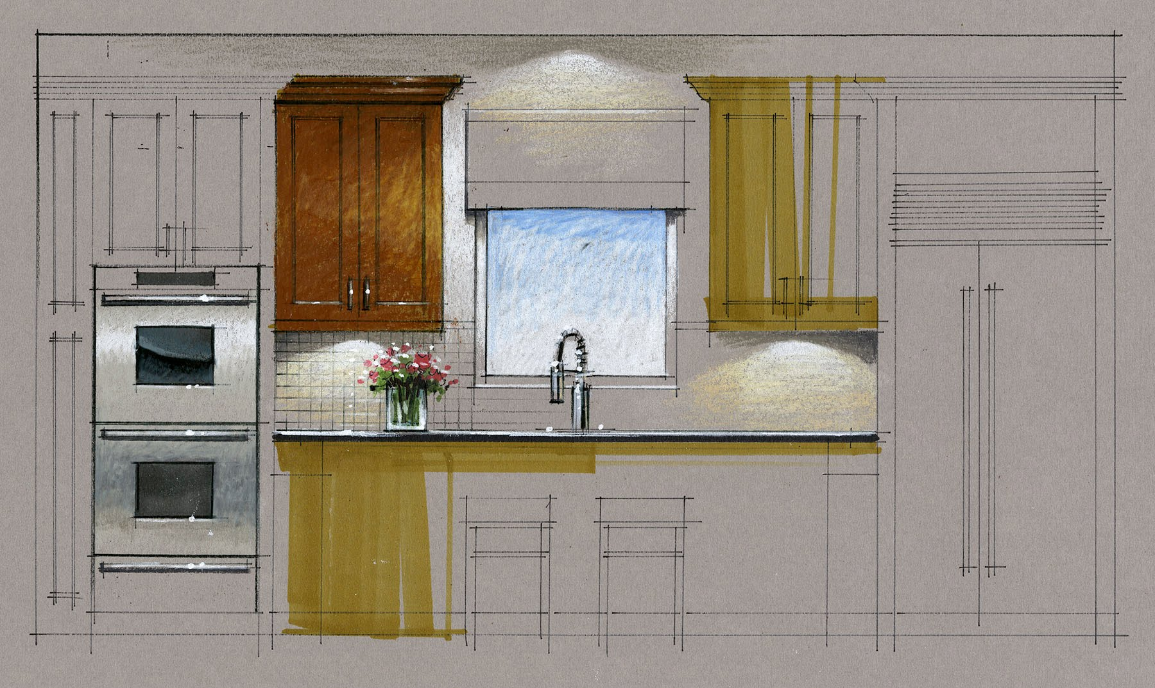

Slide 43
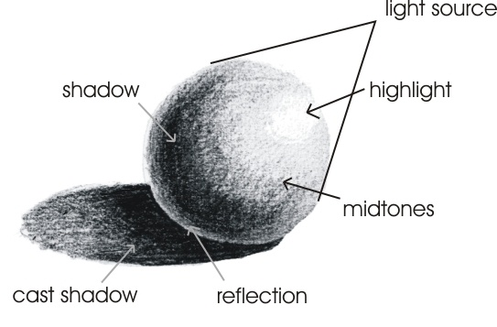
Rendering anything is trying to capture a feeling of light on surfaces

Slide 44
Cast shadows from natural light souces

Slide 45
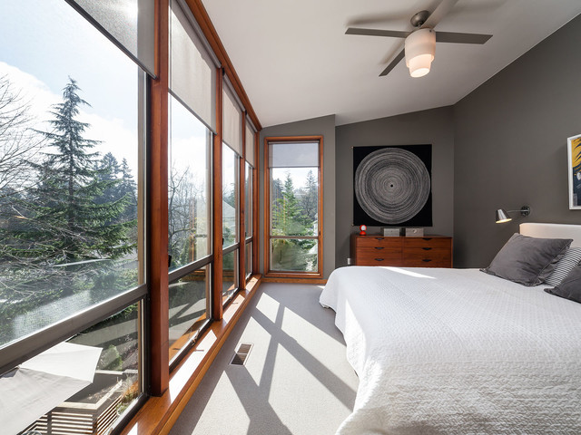
Note the rays from sunlight are parallel, so shadows will be parallel at large open windows

Slide 46
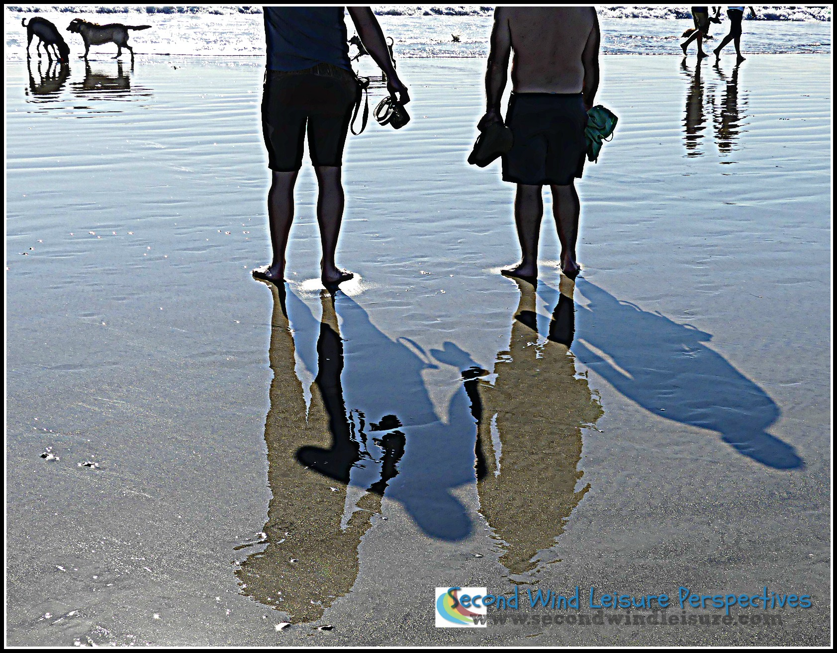
Cast shadows versus reflections

Slide 47
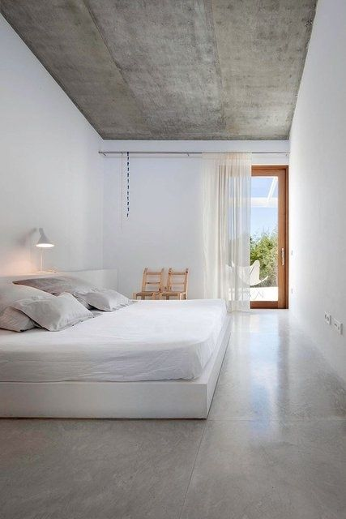
Reflections emphasized if the floor is polished

Slide 48
Reflections on horizontal surfaces

Slide 49
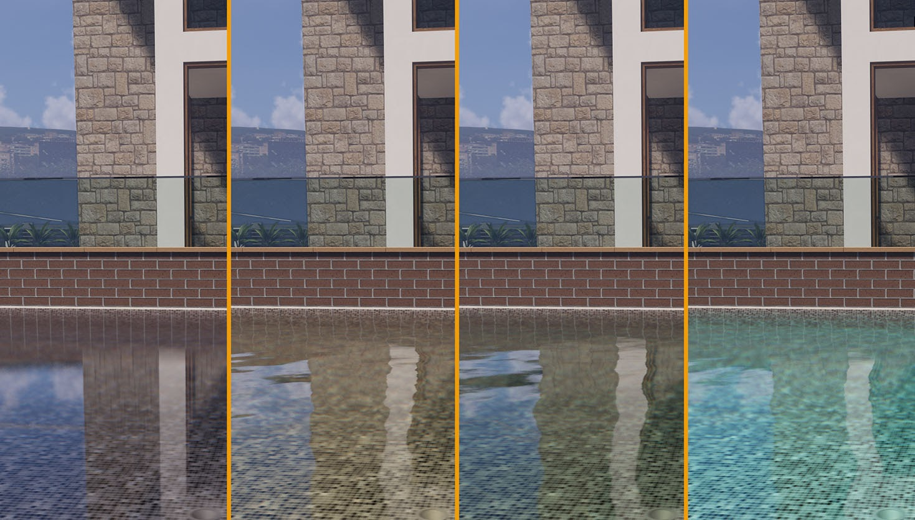
Reflections in water

Slide 50
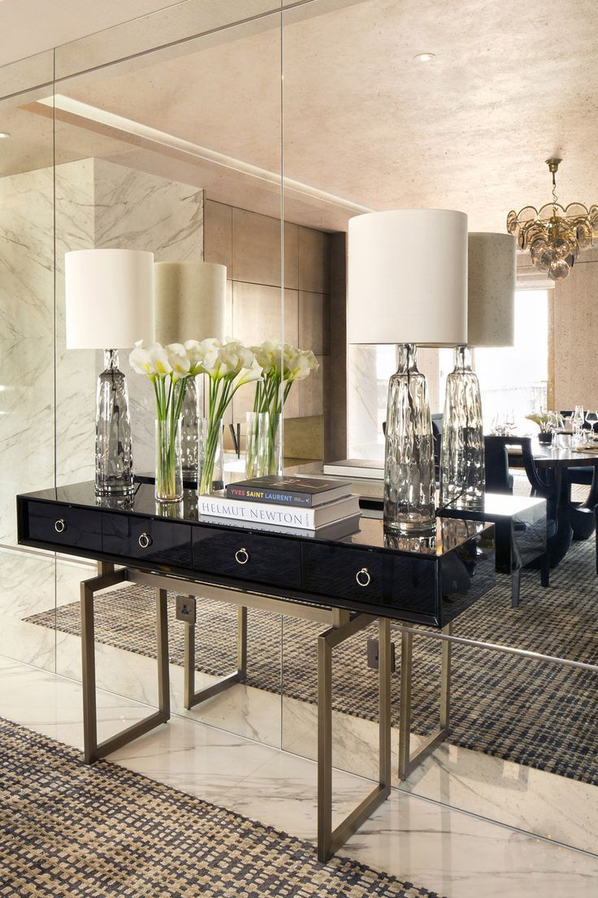
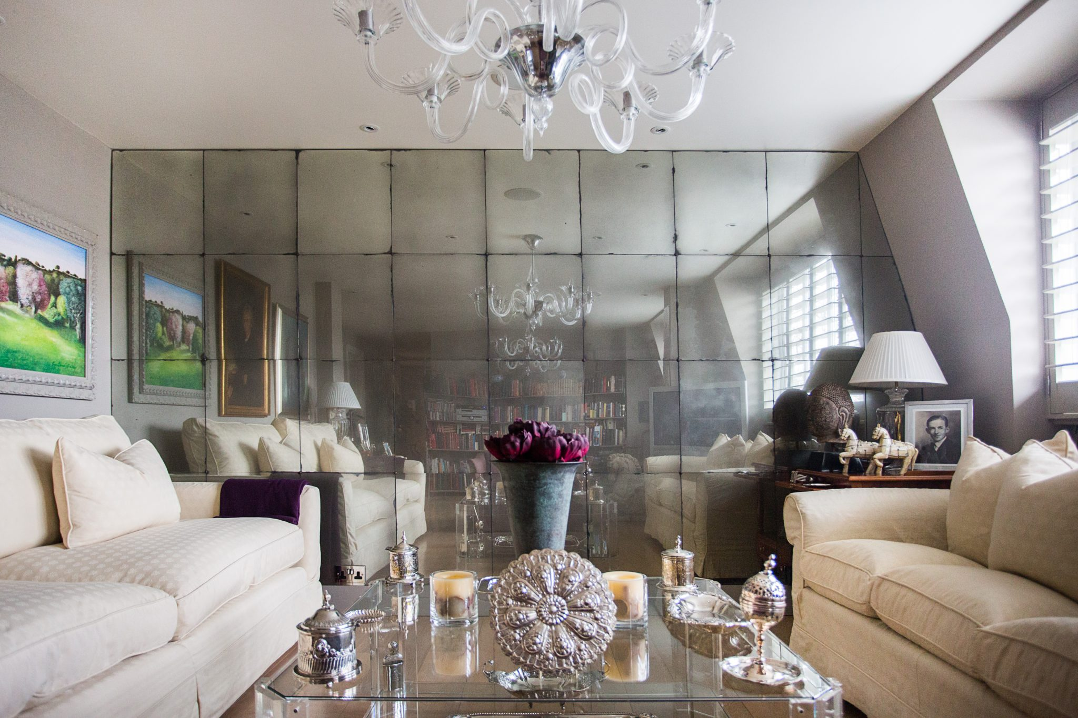
Reflections in mirror

Slide 51
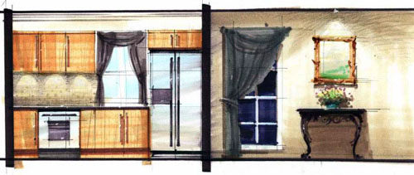
Rendered Elevation

Slide 52
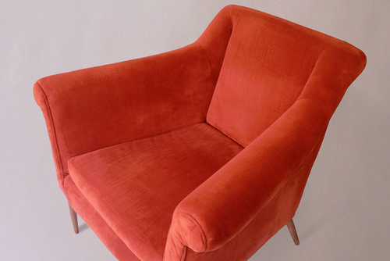
Value steps create 3-d perception on a flat 2-d surface.

Slide 54
A bold personal style can make a dramatic design statement

Slide 55
Pencil shading can create “flavoring” or reflected color to enliven a rendering and unify the composition.

Slide 56
Floor plan with flavoring

Slide 58
PORTFOLIO IDEAS
https://www.flipsnack.com/templates/minimalist-interior-design-portfolio-template
https://schoolofsketching.com/blog-in-english/portfolio

Slide 61
Quick sketch style

Slide 63
Elevation combined with “photo shop” elements

Slide 67
Project name/information
Concept word and elements used to portray the concept
Add conceptual quick sketches
Copy rendering here
Add photos of furniture, lighting etc.

Slide 73
Jerimiah goodman renderings

Slide 74
Frank Lloyd wright renderings

Slide 75
Albert Hadley sketches

Slide 76
Adding scale figures to drawing

Slide 77
Figure abstractions

Slide 82
if you hear a voice within you say “you can not paint”, then by all means paint and that voice will be silenced. The beginning is perhaps the more difficult than anything else, but keep heart, it will turn out all right. Vincent Van Gogh

